Slide 1

MongoDB and
Building REST API using MongoDB
Module 4
Notes:
15/3 - Present -
49
29
40
15
52
38
45
22
26
14
19

Slide 2
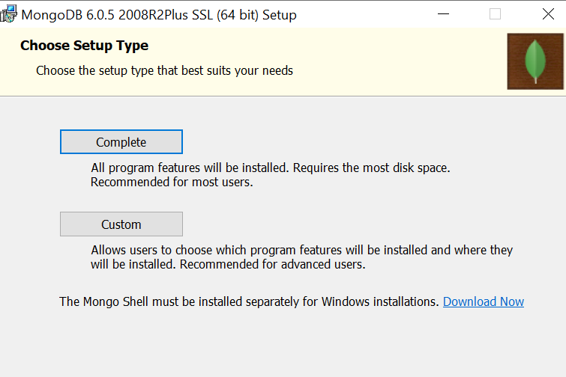
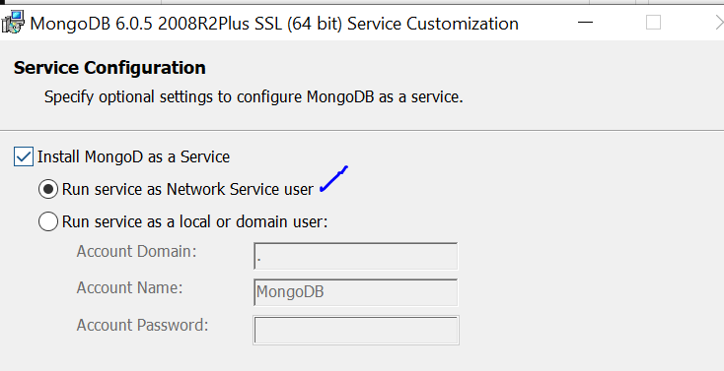
Installation: MongoDB Compass
Download
https://www.mongodb.com/try/download/community
Run Setup
Set env PATH
C:\Program Files\MongoDB\Server\5.0\bin

Slide 3
MongoDB is a Database application
NoSQL used for high volume storage
It is a Collection and Document based
NoSQL database, doesn’t follow a schema
Documents contain key (field)-value pair
Collection is a set of Documents and functions

Slide 4
SQL(MySQL) VS NoSQL(MongoDB)
1. RDBMS ia a relational DB and
works on Relational Database.
2. It stores data in the form of
entity as table.
3. To perform CURD operation,
SQL is used to query DB.
4. Tables, rows, columns
1. Non Relational, Document Oriented
DBMS and works on Document Databases.
2. Stores data in the form of
Documents
3. Uses BSON to query DB
4. Collection, Document, Field
Notes:
Compare JSOn and BSON
https://www.mongodb.com/json-and-bson

Slide 5
MongoDB Features
Each database contains collections which in turn contains documents. Each document can be different with a varying number of fields. The size and content of each document can be different from each other.
The document structure is more in line with how developers construct their classes and objects in their respective programming languages.
The rows (or documents as called in MongoDB) doesn’t need to have a schema defined beforehand. Instead, the fields can be created on the fly.
The data model available within MongoDB allows you to represent hierarchical relationships, to store arrays, and other more complex structures more easily.

Slide 6
WireTiger
WiredTiger storage engine in MongoDB plays a vital role by providing
efficient storage
document-level concurrency control
ACID compliance
Compression
Encryption
Scalability.

Slide 7
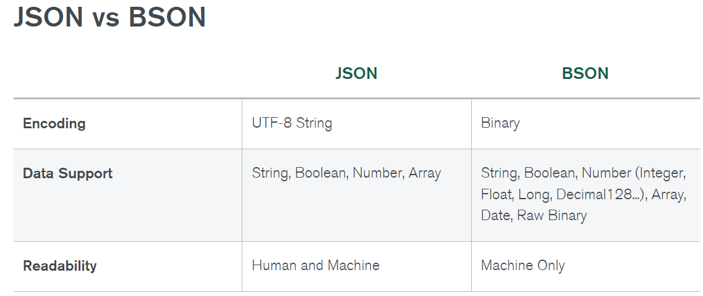
Notes:
https://www.mongodb.com/json-and-bson

Slide 8
What are alternatives to MongoDB?
Cassandra,
CouchDB,
Redis,
Riak
are a few good alternatives

Slide 9

First MongoDB Script
Notes:
var msg=’Hello World’;
printjson(msg);

Slide 10
Create database, collections, documents
Start cmd prompt
Run mongosh as command
Run show dbs to check default databases
Create new database-
use db1 ....this command creates DB if it is not already exists, and let you start working if it does exists.
show dbs ...wont show up created DB if it is empty.
To add document
To add collection.

Slide 11
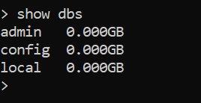


Default database
Displays all database
Find current DB
Create Collection ( new or switches)
Empty dbs are not listed by show
Db names are case sensitive

Slide 12

Show collections in the current DB
CRUD operations
Insert 1 document
Collection is not Schema dependent
Documents with different number and type of fields can be inserted

Slide 13
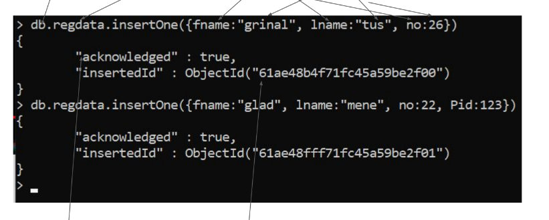
REFERS TO CURRENT db
NAME OF THE DOCUMENT
FIELD
VALUE
ONE ROW WITH THREE COLUMNS ARE ADDED
PRIMARY KEY

Slide 14
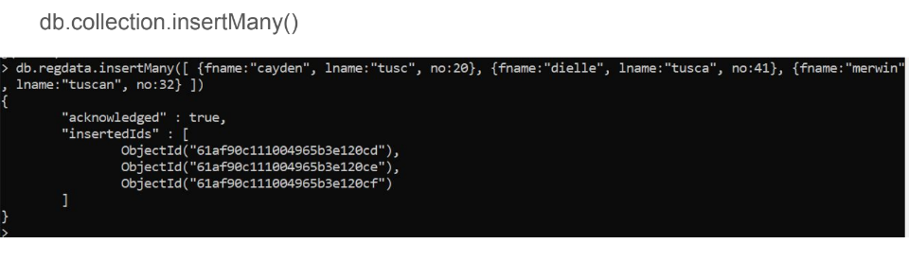
Insert Many documents

Slide 15
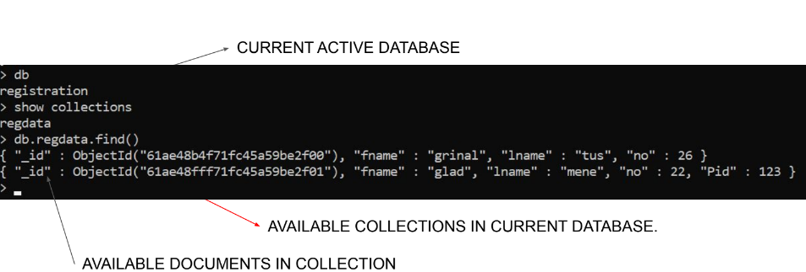
View document inserted
db.collection.find()

Slide 16
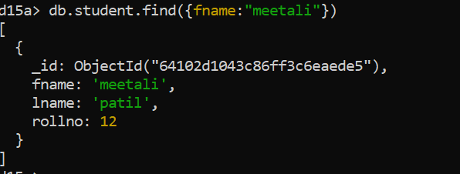
Search
Find collection with specific field only
Without _id

Slide 17
What happens here?

Slide 18
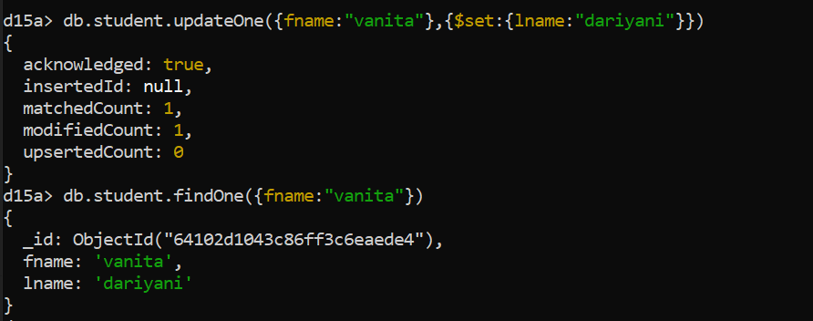
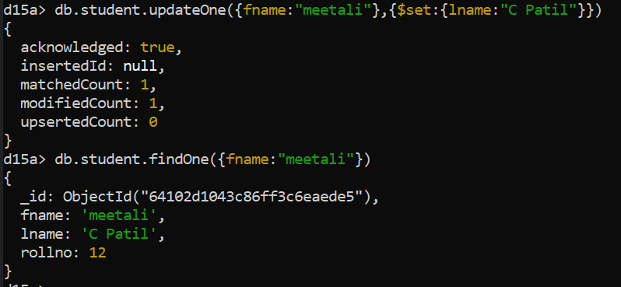
Update
UpdateOne()=>db.collection.updateOne(<filter>, <update>)
UpdateMany()=>db.collection.update(<filter>, <update>)

Slide 19
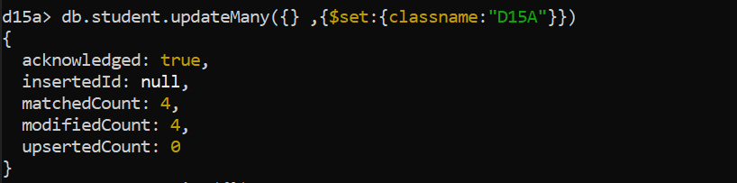
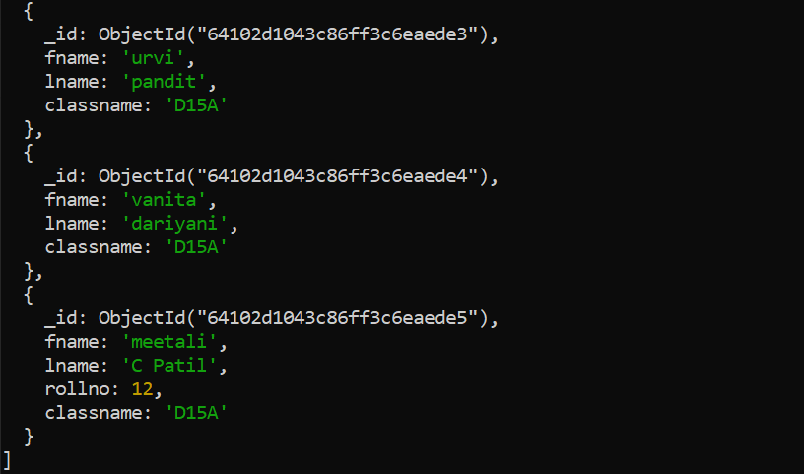
UpdateMany

Slide 20
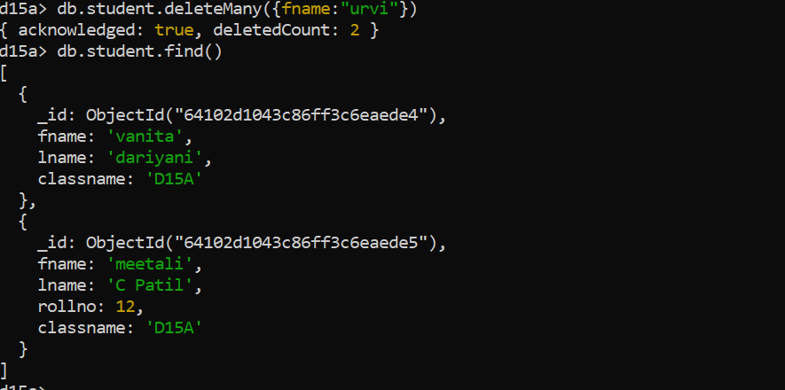
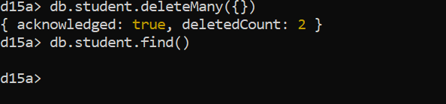
Delete
Delete all documents

Slide 21
Key Components of MongoDB Architecture
_id
This is a field required in every MongoDB document.
The _id field represents a unique value in the MongoDB document.
The _id field is like the document’s primary key.
If you create a new document without an _id field, MongoDB will automatically create the field.
No two documents will have same _id

Slide 22
Collection
This is a grouping of MongoDB documents.
A collection is the equivalent of a table which is created in any other RDMS such as Oracle or MS SQL.
A collection exists within a single database.
Database
This is a container for collections like in RDMS wherein it is a container for tables.
Each database gets its own set of files on the file system.
A MongoDB server can store multiple databases.

Slide 23
Document
A record in a MongoDB collection is basically called a document.
The document, in turn, will consist of field name and values.
Field
A name-value pair in a document.
A document has zero or more fields.
Fields are analogous to columns in relational databases.

Slide 24
Why use MongoDB
Document-oriented
Since MongoDB is a NoSQL type database, instead of having data in a relational type format, it stores the data in documents. This makes MongoDB very flexible and adaptable to real business world situation and requirements.
Ad hoc queries
MongoDB supports searching by field, range queries, and regular expression searches. Queries can be made to return specific fields within documents.

Slide 25
Replication
MongoDB can provide high availability with replica sets.
A replica set consists of two or more mongoDB instances.
Each replica set member may act in the role of the primary or secondary replica at any time.
The primary replica is the main server which interacts with the client and performs all the read/write operations.
The Secondary replicas maintain a copy of the data of the primary using built-in replication.
When a primary replica fails, the replica set automatically switches over to the secondary and then it becomes the primary server.

Slide 26
Indexing
Indexes can be created to improve the performance of searches within MongoDB.
Any field in a MongoDB document can be indexed.
Load balancing
MongoDB uses the concept of sharding to scale horizontally by splitting data across multiple MongoDB instances.
MongoDB can run over multiple servers, balancing the load and/or duplicating data to keep the system up and running in case of hardware failure.

Slide 27
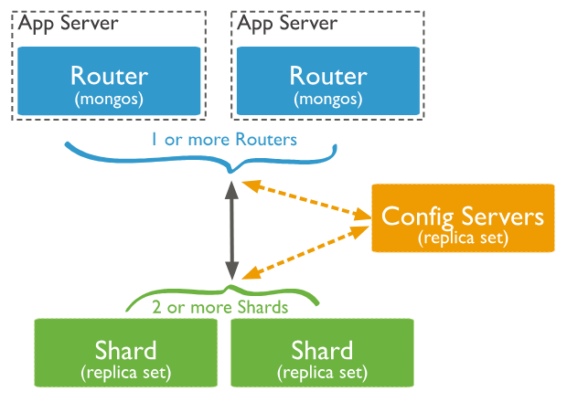
Sharding
Supports Sharding which is the process of dividing large datasets across multiple collections to ensure that queries can be executed efficiently.
Splitting up large Collections into Shards allows MongoDB to execute queries without putting much load on the Server.
MongoDB Sharding can be implemented by creating a Cluster of MongoDB Instances.
Notes:
https://www.geeksforgeeks.org/mongodb-replication-and-sharding/
https://www.mongodb.com/docs/manual/sharding/

Slide 28
Data Types in MongoDB
String − This is the most commonly used datatype to store the data. String in MongoDB must be UTF-8 valid.
Integer − This type is used to store a numerical value. Integer can be 32 bit or 64 bit depending upon your server.
Boolean − This type is used to store a boolean (true/ false) value.
Double − This type is used to store floating point values.
Min/ Max keys − This type is used to compare a value against the lowest and highest BSON elements.
Arrays − This type is used to store arrays or list or multiple values into one key.

Slide 29
Timestamp − ctimestamp. This can be handy for recording when a document has been modified or added.
Object − This datatype is used for embedded documents.
Null − This type is used to store a Null value.
Symbol − This datatype is used identically to a string; however, it's generally reserved for languages that use a specific symbol type.
Date − This datatype is used to store the current date or time in UNIX time format. You can specify your own date time by creating object of Date and passing day, month, year into it.
Object ID − This datatype is used to store the document’s ID.
Binary data − This datatype is used to store binary data.
Code − This datatype is used to store JavaScript code into the document.
Regular expression − This datatype is used to store regular expression.

Slide 30
Operators
Comparison Operators:
$eq: Matches values that are equal.
$ne: Matches values that are not equal.
$gt, $lt, $gte, $lte: Greater than, less than, greater than or equal to, less than or equal to.
Logical Operators:
$and, $or, $not: Logical AND, OR, NOT.
Element Operators:
$exists: Matches documents that have the specified field.
$type: Matches documents based on the BSON type.

Slide 31
Array Operators:
$in: Matches any of the values specified in an array.
$all: Matches arrays that contain all elements specified in an array.
Text Search:
$text: Performs a text search.
Regular Expression:
$regex: Matches documents based on regular expression patterns.
Arithmetic Operators:
$add, $subtract, $multiply, $divide: Performs arithmetic operations.

Slide 32
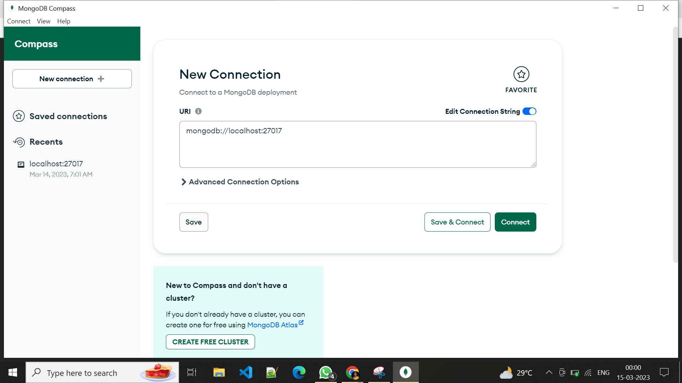
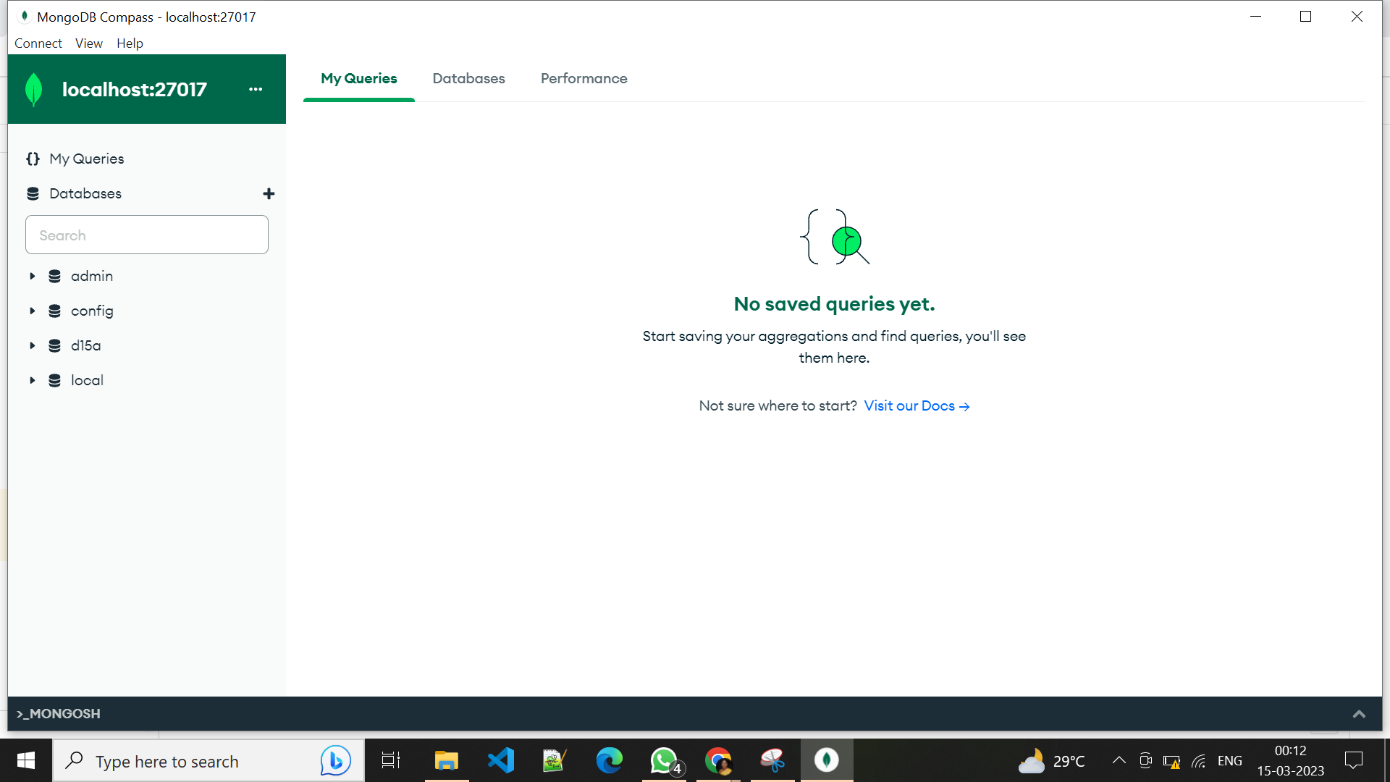
MongoDB Compass (GUI)
Connect

Slide 33
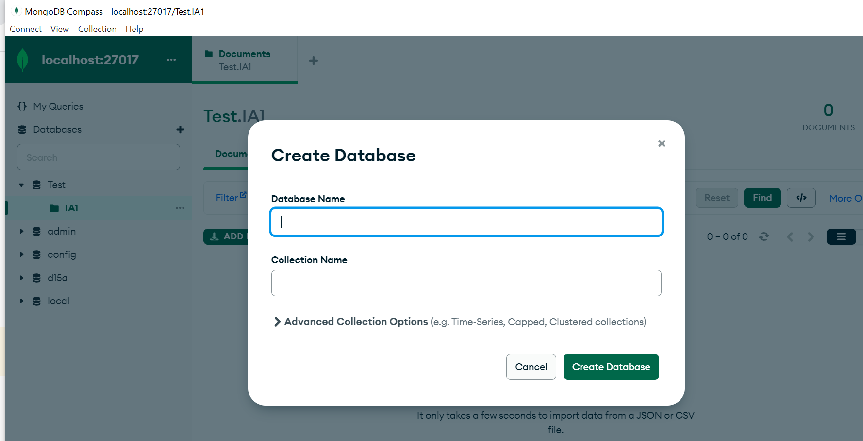
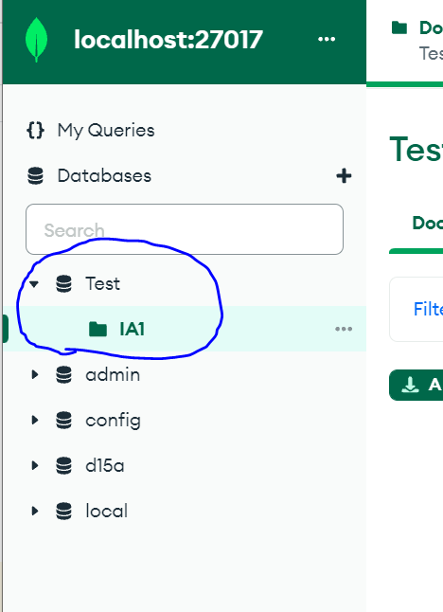
Create Database

Slide 34
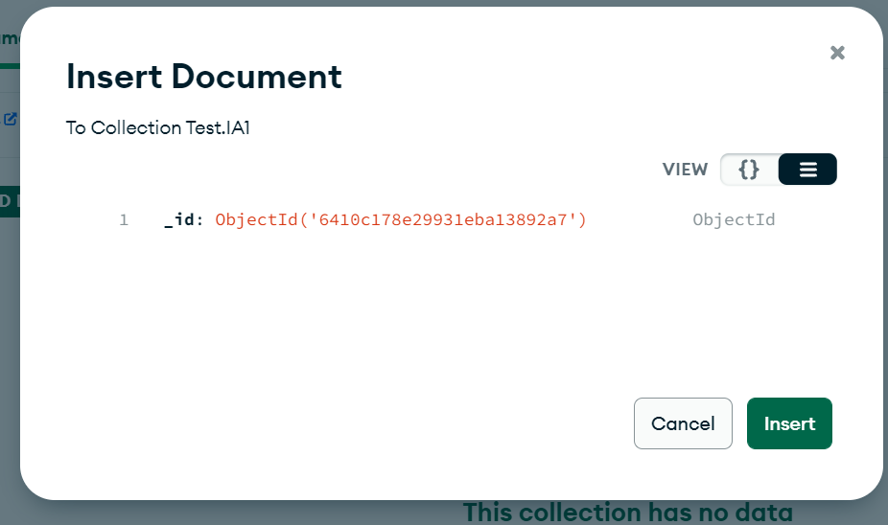
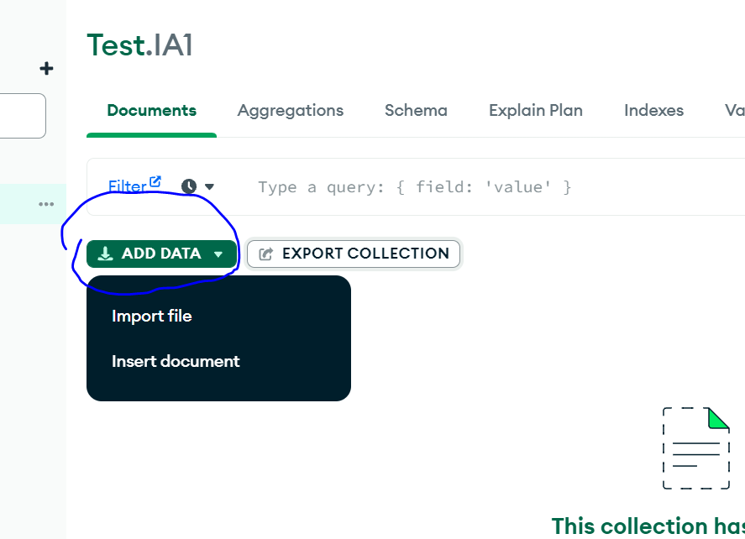
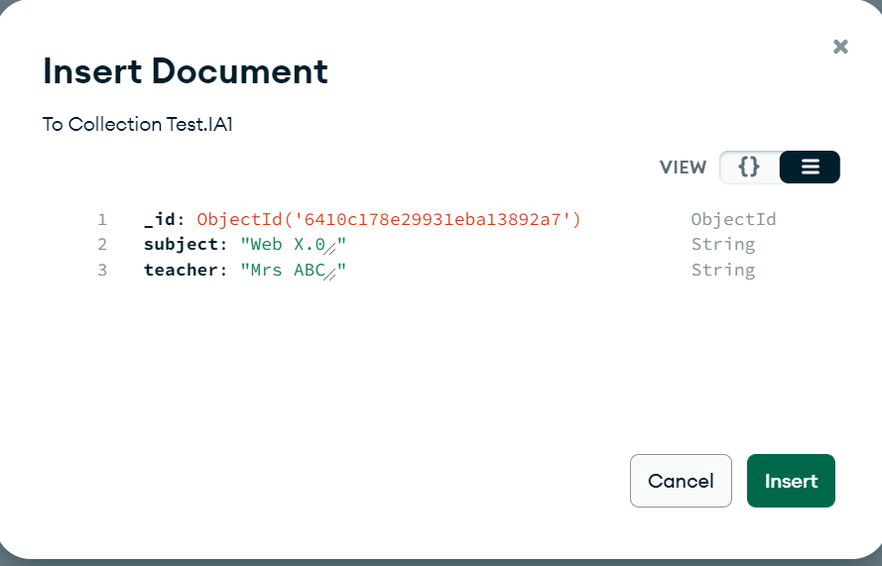
Insert documents

Slide 35
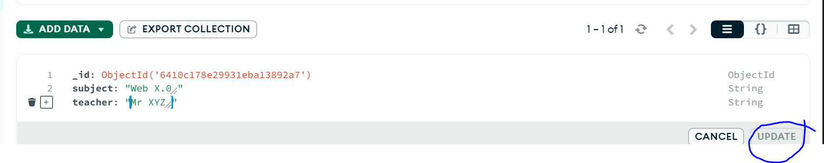
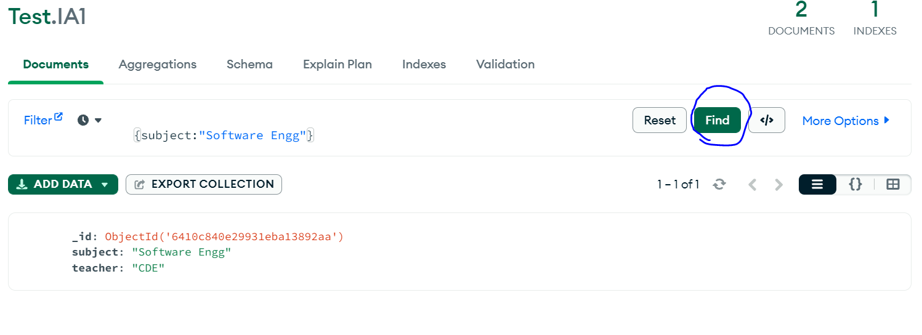
Update
Double click on the document to change and click update
Search

Slide 36
Moongose
Mongoose: Mongoose is a MongoDB object modeling tool designed to work in an asynchronous environment.
Mongoose helps in establishing connection between MongoDB and Node JS.
Mongoose provides a straight-forward, schema-based solution to model your application data.
It includes built-in type casting, validation, query building, business logic hooks and more, out of the box.

Slide 37
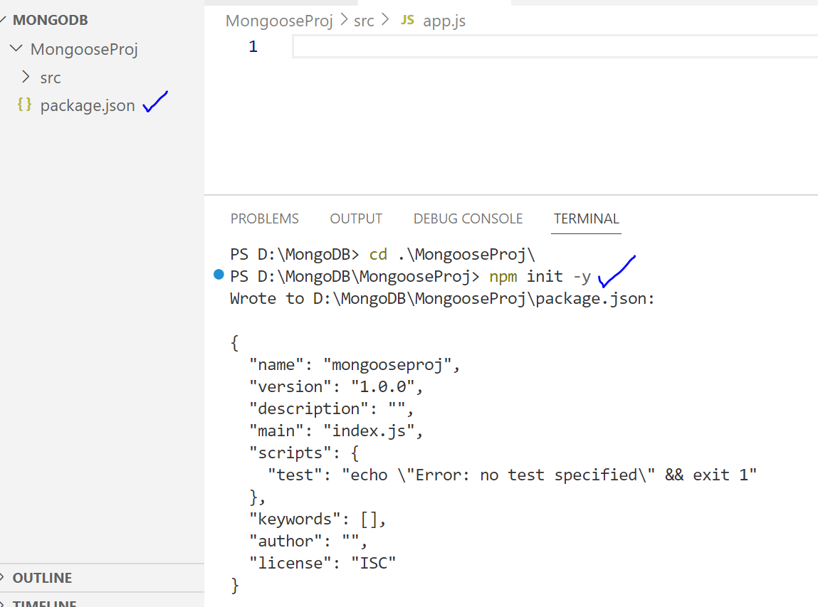
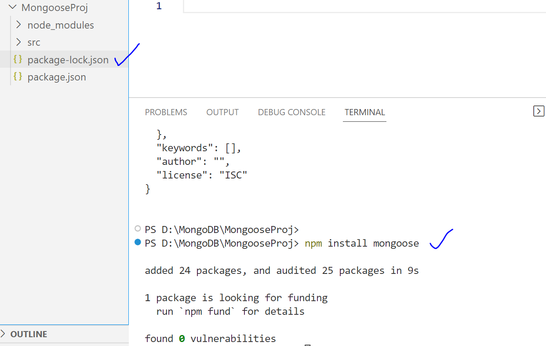
Checking for dependencies
Setting up Mongoose
npm init -y
npm install mongoose

Slide 38
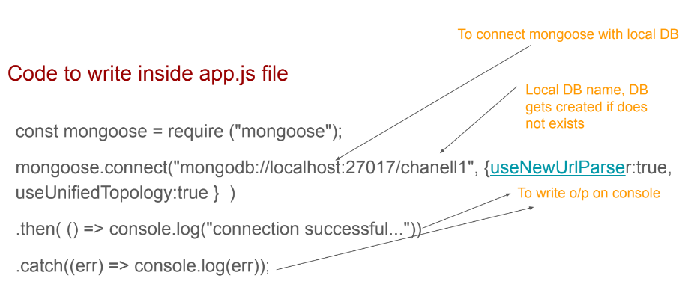
To create and connect to DB, define schema and create collections using mongoose models
Connect to server
Notes:
useNewUrlParser
https://arunrajeevan.medium.com/understanding-mongoose-connection-options-2b6e73d96de1

Slide 39
Schema and Models in mongoose
Schema defines the structure of the document, default values and validators etc..
Eg: schema defines data type of key value pair.

Slide 40
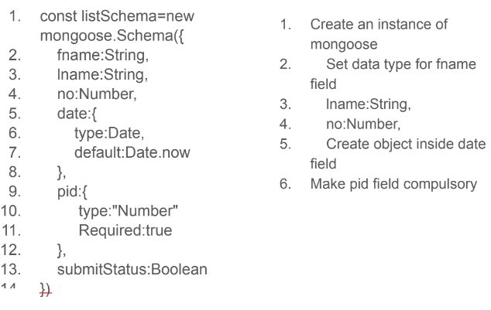
Add to app.js

Slide 41
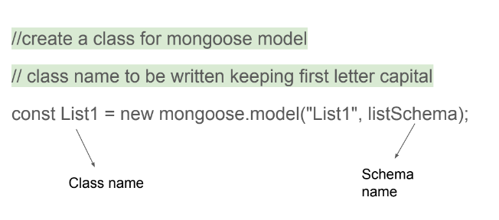
Model
Mongoose model provides an interface to the database for querying, Creating, updating, deleting records etc..

Slide 42
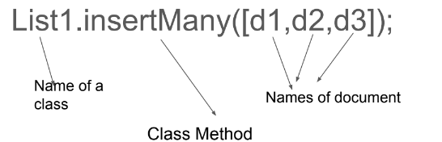
Create multiple collections using mongoose model

Slide 43
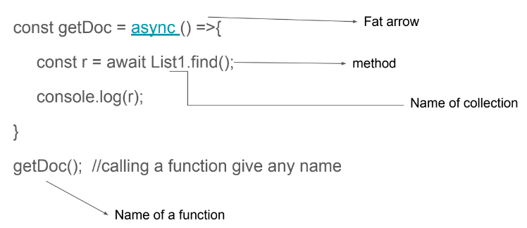
Read documents using mongoose

Slide 44
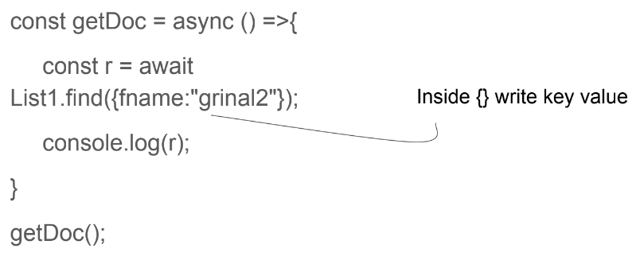
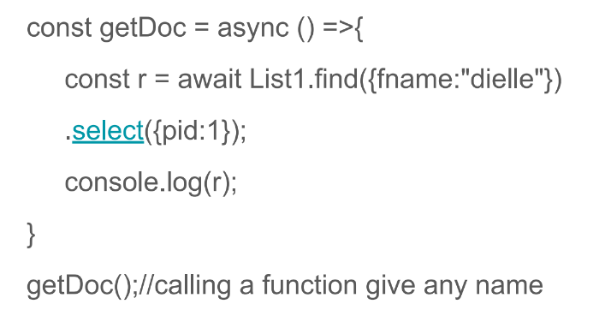
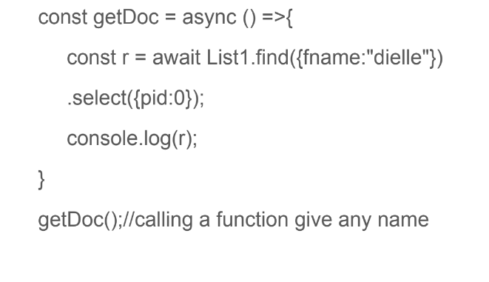
Read a specific documents using mongoose

Slide 45
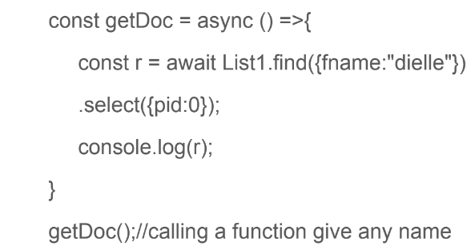
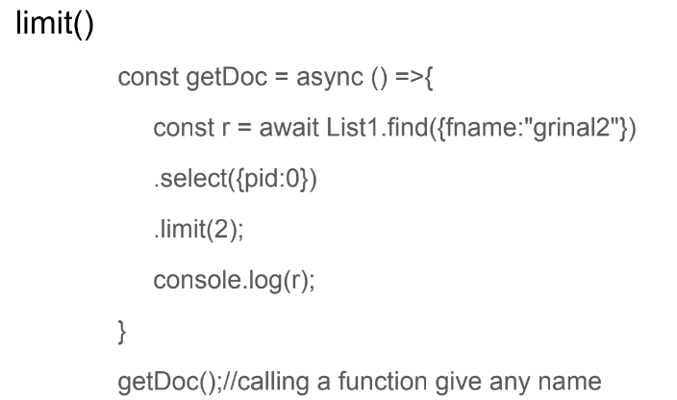
Select _ exclude field

Slide 46
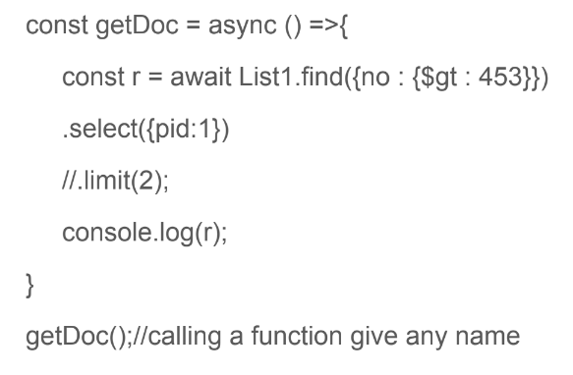
Display all documents with only pid that has ‘no’ greater than 452

Slide 47
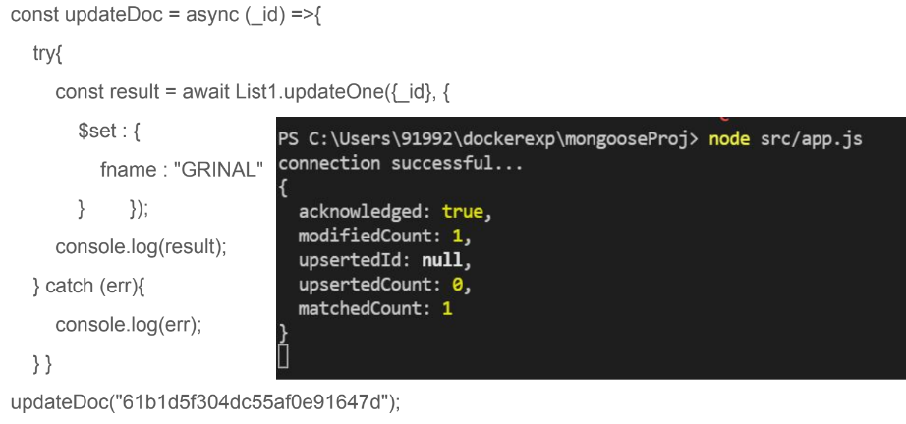
Express with Mongo to update documents
Notes:
Install Express : npm install express

Slide 48
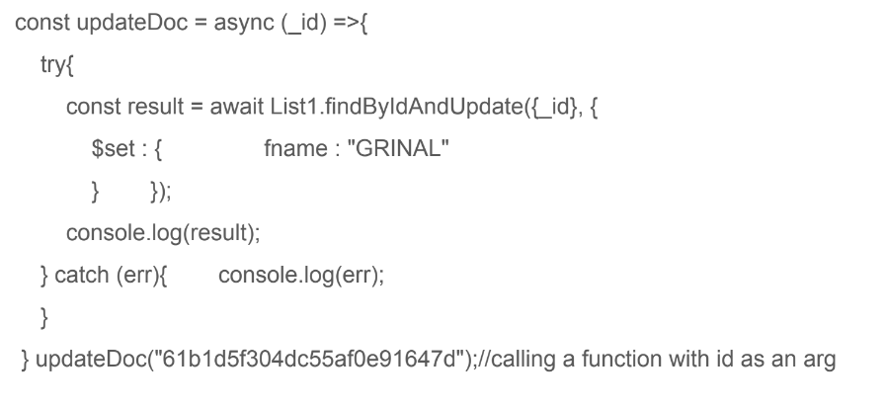

Slide 49
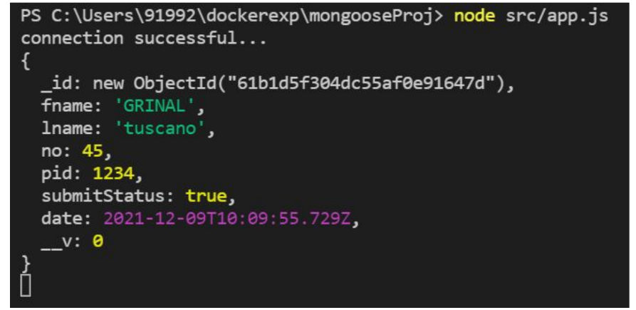

Slide 50
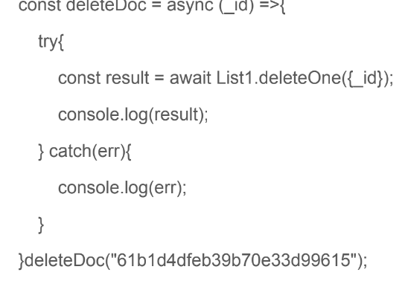
Delete one document

Slide 51
REST API

Slide 52
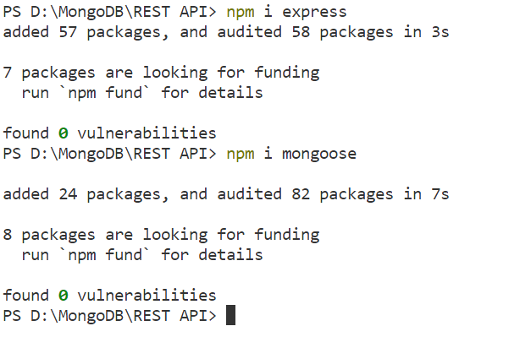
Notes:
npm install -g nodemon

Slide 53
const express = require('express')
const app = express()
const mongoose = require('mongoose')
app.listen(3000, () => console.log('Server Started'))

Slide 54
Administering User Accounts

Slide 55
Configuring Access Control

Slide 56
What is AJAX? Explain Working of AJAX in detail.
Understanding MongoDB,, Administering User Accounts, Configuring Access Control,
https://www.guru99.com/mongodb-create-user.html
https://www.javatpoint.com/mongodb-user-management-methods
REST API: Examining the rules of REST APIs, Evaluating API patterns, Handling typical CRUD functions (create, read, update, delete), Using Express and Mongoose to interact with MongoDB, Testing API endpoints
https://www.youtube.com/watch?v=fgTGADljAeg
https://www.youtube.com/watch?v=eYVGoXPq2RA
https://www.youtube.com/watch?v=WDrU305J1yw

